Slide 1
Sanitary Engineering
Sewerage Engineering
Secondary Treatment System
By
Dr. Muhanad M. Abbas

Slide 2
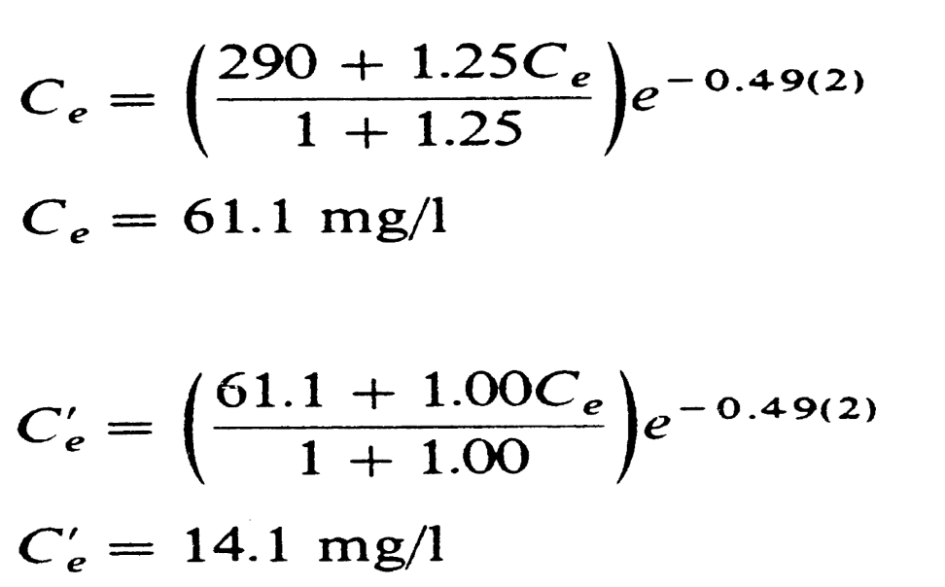
Trickling Filter Efficiency
Velz Formula

Slide 4
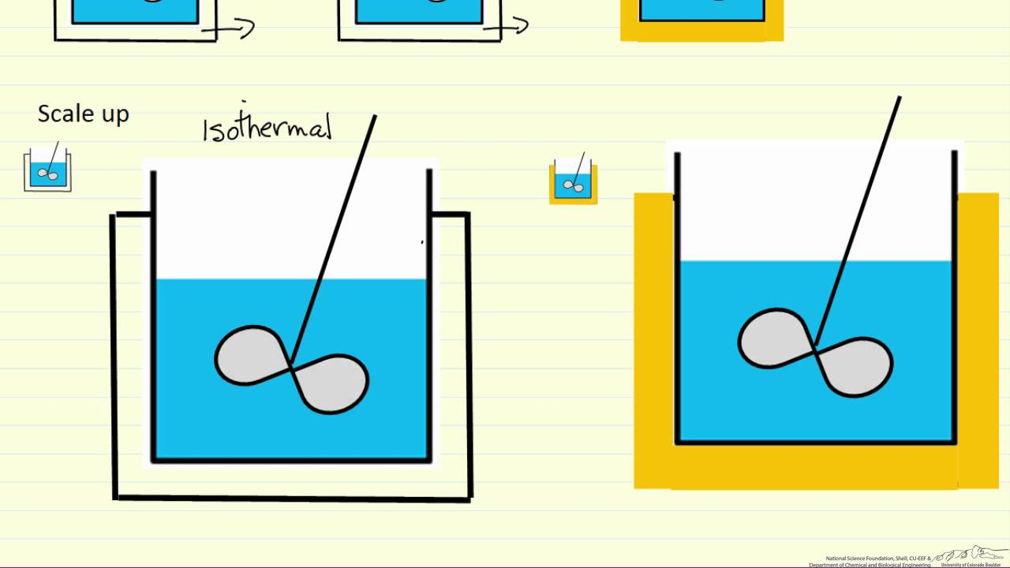
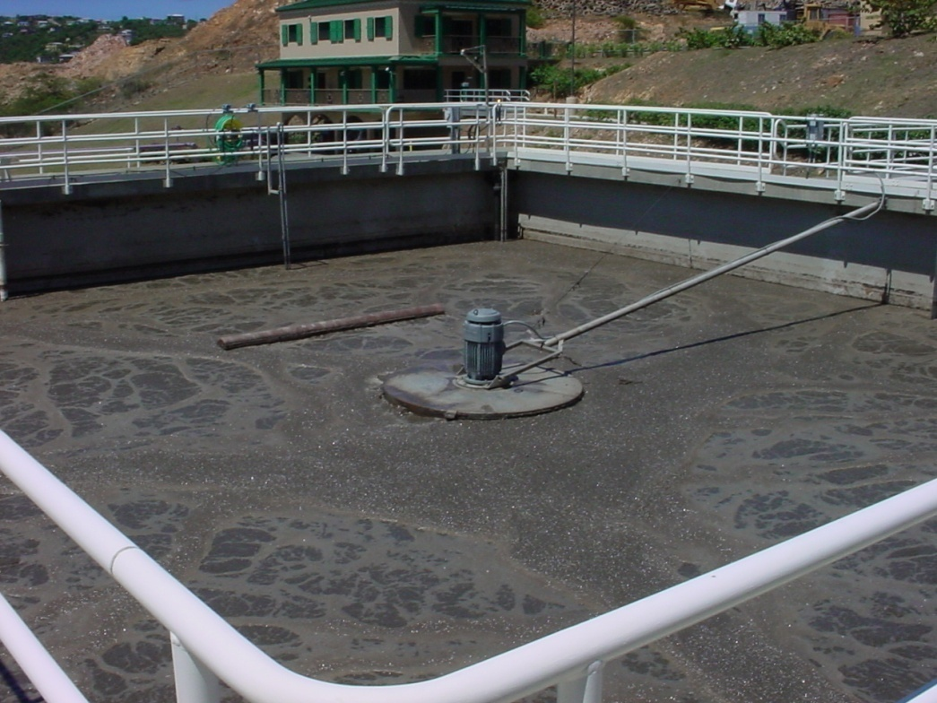
Batch reactor

Slide 5
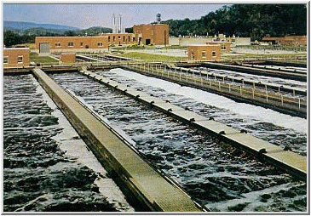
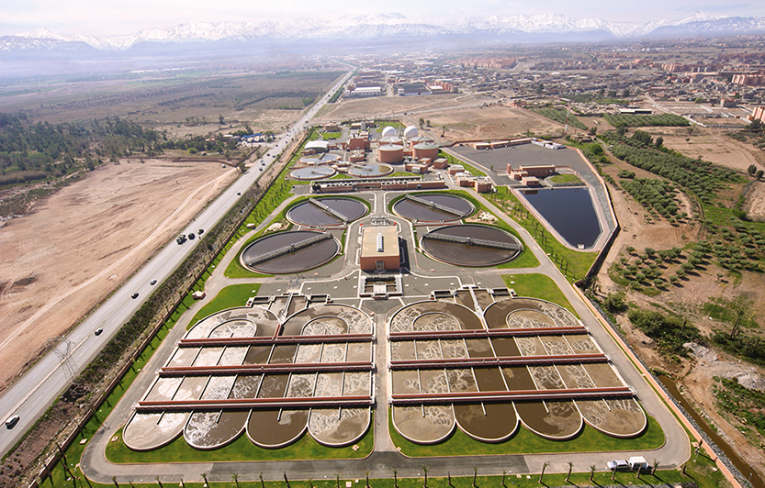
Plug flow reactor

Slide 6
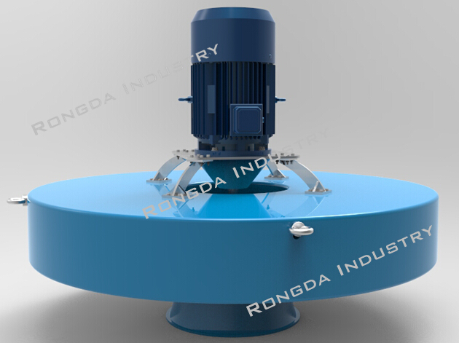
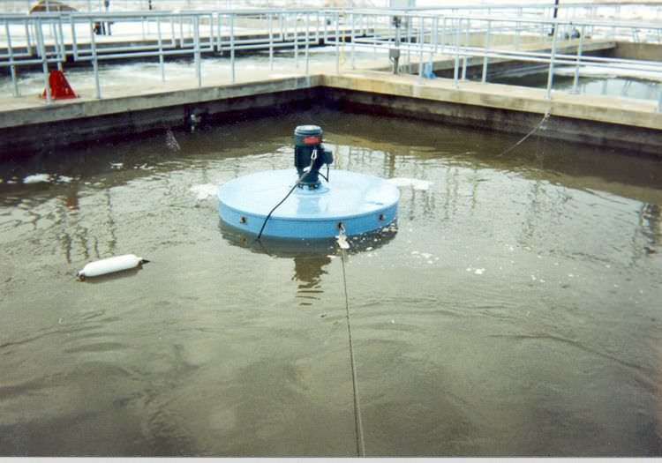
Floating reactor

Slide 7
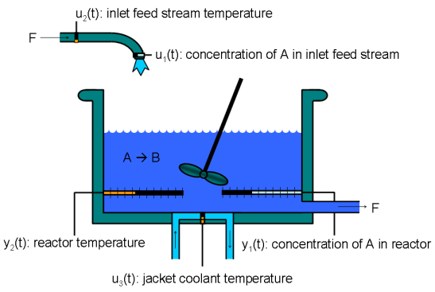
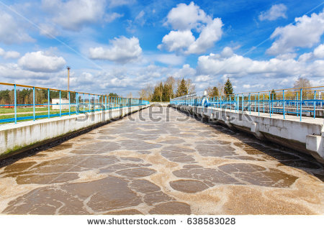
Continuous flow stirred tank reactor

